Slide 1
Hostel Mess Database system
DBMS Mini Project
RA1911003010812 Dharva Khambholia
RA1911003010813 Pushkar Verma
RA1911003010816 Avirup Biswas

Slide 2
Proposal:-
The basic purpose of designing this project is to get rid from manual entry and record system and try to give easy and simple database management system for hostels.
This project is designed to keep the record of the students living in hostel, allocation of rooms, their monthly or semester wise dues and many more things but we are trying to make this management system as much as simple and easy as we can, but we will try to cover all the basic elements use for hostel management database.
If we talk in simple functionality of this project so our basic target is to keep database of students in hostels with different angles such that their room number, fees status, their course name, semester and can be many more.
As mentioned earlier we will try to make our project easy and simple so it can be implement at any level and can be productive and useful for any hostel administration.

Slide 3
E-R Diagram and Business Rules:-
Hostel management system is designed so that our universities and colleges can easily manage the data of students and related information. For the best understanding first we have to define the project scope or the scenario because different problem can be solve different design and more than one scenarios can be created for each problem. People design them according to their thinking.
We are also creating some type scenario so that our design can be bit specific for some kind of situation.
Our project is defined as;
As we can see that our university has the facility of hostel for boys and girls.
We will focus on the boy’s hostel only as almost all the things will be same in both hostel we will manage only boys so that it will be simple and easy to understand for everyone.
Obviously many students will be living in the boy’s hostel.
Boy’s hostel has many rooms for the accommodation of the students in which more than one student accommodate their self.
Each room has assigned different types of furniture for the students so they can easily spend the time in room.
There are many workers in the boy’s hostel who work in the mess and hostel as well (cleaning, washing etc );
Every student must submit his fees in-time so they can get the every facility in hostel.
For the food service the hostel management is providing the facility of mess for students so students and easily get the meal in hostel.
It is also possible that visitors can come to meet students those are living in hostel.

Slide 4
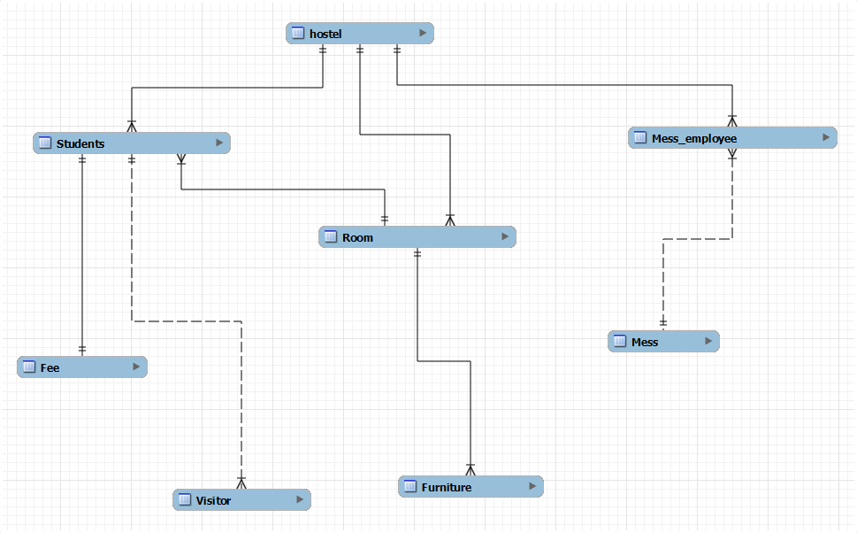
E-R Diagram

Slide 5
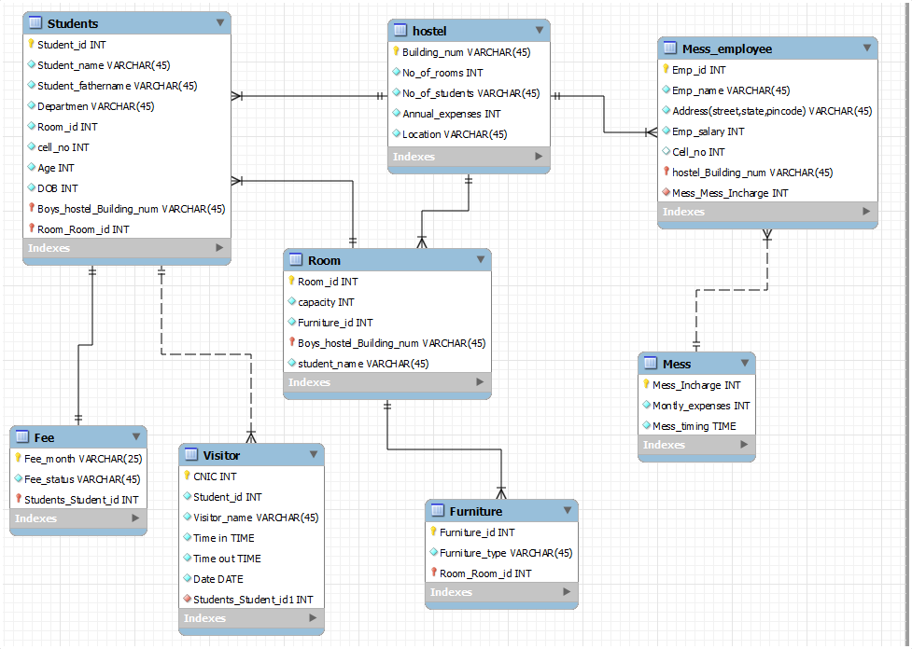

Slide 6
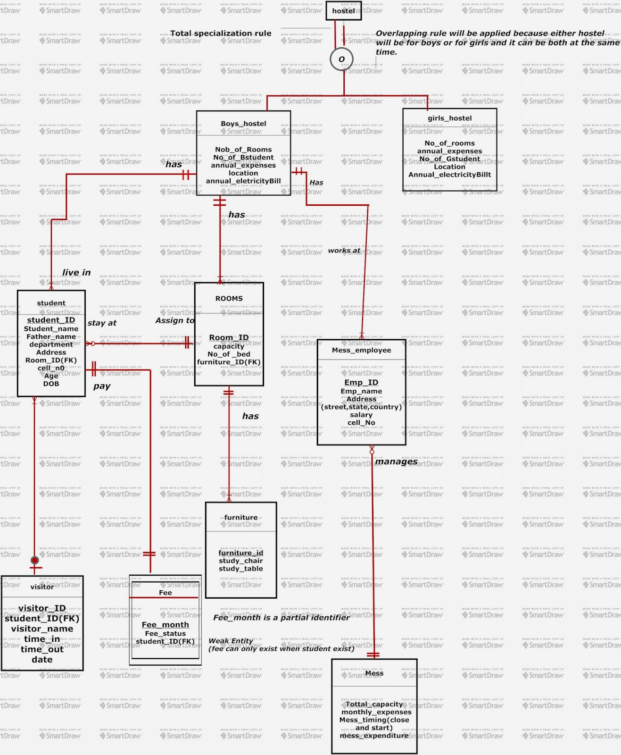

Slide 7
Formal Specification:-
This document is explaining about the entities we are using in the project, reason for choosing the entities their attributes how they will work ,data_type, size, primary key, foreign key , constraints (if exists) and flow of data that how the data will move between the entities.
Basically this is designed to make it more easy and understandable for everyone.
Entities:
1. hostel
2. Students
3. Fees
4. Room
5. Furniture
6. Mess
7. Mess_employee/staff
8. Visitor

Slide 8
Hostel:-
Many institutes provide the facility of hostel for boys and girls.
But we are mentioning only boys here , almost all the working is same in both hostels.
Reason:
We are taking the entity named as hostel because from here data will move to other entities and we will manage the database.
This entity will manage the data of students in hostel.
Attributes:
If we talk about the attributes, there can be many but we have mention only few those will be more help full to make the project workable and simple.
Datatype And Size:
Each attribute have the suitable data-type and size according to the requirement.
Primary Key:
Building_num because one institute can have more than one block or building so by assigning the num it will be easy to track the data.
Constraints:
Primary key should be unique and cannot be null.
Data Flow:
Only administrator will get in the system and manage the database and check the status of students and will allocate the room to new students.
It will also do the check and balance of mess.
The data will move from here to different side like the branches of tree.

Slide 9
Room:
Students come in the hostel to get the room.
Reason:
Room will be allotted to different students, so the students can be accessed by the attributes of room as well.
Attributes:
There can be many attribute in this entity
No_of_students, Students_name, furniture_id ,student_id can be added as a foreign key to relate the both entities.
As we have composite foreign key this is coming from admin to student and then student to room.
Datatype And Size:
Each attribute have the suitable data-type and size according to the requirement.
Primary Key:
Room_id is the primary key and it can’t be null.
Constraints:
Primary key should be unique and cannot be null.
As we have composite foreign key in this table which is of boys_hostel_admin and student so there data-type size and values should be same.
Data Flow:
We can also see that there is a composite foreign key which is of boys_hostel_admin and student so data will flow from admin to student and student to room.
But in ER diagram we can see there is direct relation of admin and room so admin can retrieve the condition and data of room directly as well.

Slide 10
Fees:
Obviously when students will live in the hostel they will submit fee.
Reason:
This is weak entity here because if the student will exist then fee will be submitted other-wise not.
When students will live in hostel there will be fees charges on the monthly basis.
Attributes:
There will be few attributes because it is the weak entity and just made to
keep the fees status of student.
Datatype And Size:
Each attribute have the suitable data-type and size according to the requirement.
Primary Key:
student_id is the primary key and it can’t be null.
Constraints:
student_id is the primary key and foreign key as well. it can’t be null.
Data Flow:
The data will follow the route, admin to student and then fees.
Admin will check the student status by getting in the student entity and fees is a weak entity attached to the student so admin will be able to check the fees status of student.

Slide 11
Furniture:
Reason:
The reason for adding this entity is to just track the either students are getting the facilities promised by the institute or not.
Attributes:
Furniture_type: chair, table etc
Datatype And Size:
Each attribute have the suitable datatype and size according to the requirement.
Primary Key:
Furniture_id
Constraints:
Primary key should be unique and cannot be null.
Foreign key (room_id) will be same as values in room relation
Data Flow:
The data come from room boys_hostel_admin will track through it.

Slide 12
Mess:
Students will get the facility of mess
Reason:
Students will get the facility of mess. It can be considered as marketing strategy so more students will come in this hostel because every hostel do not give this facility.
Attributes:
There will be mess incharge , who will handle the mess, there will be monthly expenses of each student, students name to know which have got their meal or not.
Mess timing can be added to make the environment much better.
Datatype And Size:
Each attribute have the suitable data-type and size according to the requirement.
Primary Key:
Mess_incharge will be the primary key
Constraints:
Primary key should be unique and cannot be null.
Data Flow:
Admin will check the mess staff and then staff will manage it.

Slide 13
Mess_employees:
Reason:
There will be staff in mess and hostel as well.
Some will work in mess and others like sweepers in hostel and many more.
Attributes:
Employee_name, address, salary, cell_no etc are the attributes used in this entity.
Datatype And Size:
Each attribute have the suitable datatype and size according to the requirement.
Primary Key:
Employee_id is used as a primary key.
Constraints:
Primary key should be unique and cannot be null.
Mess_incharge will be foreign key in this table.
Data Flow:
The data will flow from admin to staff and then mess.

Slide 14
Visitors:
Reason:
This entity is added as the extra entity so that our project can be look complete from every aspect.
Attributes:
Student_id,visitor_name,time_in,time_out,date these are the attributes to check what time visitor came and when he/she will leave the hostel.
Datatype And Size:
Each attribute have the suitable datatype and size according to the requirement.
Primary Key:
CNIC is considered as primary key.
Constraints:
Primary key should be unique and cannot be null.
Student_id will be the foreign key in this.
Data Flow:
This is the optional entity and data will come from student and admin.
Admin can log in to see the student data in which visitor is also attached with the foreign key so admin can keep eye on the visitor position of every student.

Slide 15
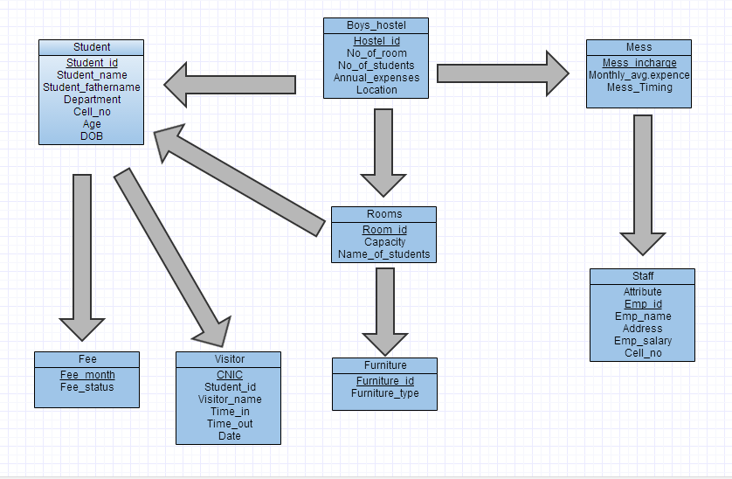
Data Flow Diagram

Slide 16
Thank You

